Slide 1

Air Canvas
Team Python thinkers

Slide 2

Team Members
Anto Francis (C0825095)
Omer Volkan Guney (C0831373)
Rupesh Chandran (C0826779)
Sachin Sreekumar (C0825096)
Reporting Week: Mar 25, 2022 to Apr 1, 2022
Supervised by
Prof. Parissa Naraei

Slide 3
AIR CANVAS project (recap)
Air canvas helps to draw on a screen just by waiving your finger fitted with a simple colored cap. We are using the computer vision techniques of OpenCV to build this project. The preferred language is python due to its exhaustive libraries and easy to use syntax.
We aiming to provide a natural human-system interaction in such way that it does’nt require keypad, pen or glove etc for character input.
Targeted features of Air Canvas;
It can track any specic colored pointer
User can draw in four different colors and even change them without any hussle.
Able to clean the board with a single location at the top of the screen.
No need to touch the computer once the program is run

Slide 4
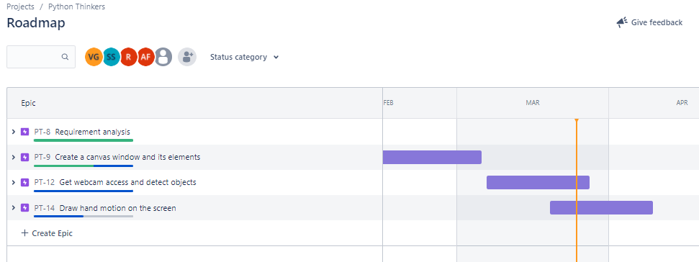
Week’s update
We have started working on the last phase of the project which is mainly categorized as «Draw hand motion on the screen».

Slide 5
Week’s update
Created Buttons for changing colors of drawings in the Canvas
We have added a summary of the project in the first page of our ppt.
Explored drawing functions in OpenCv

Slide 6
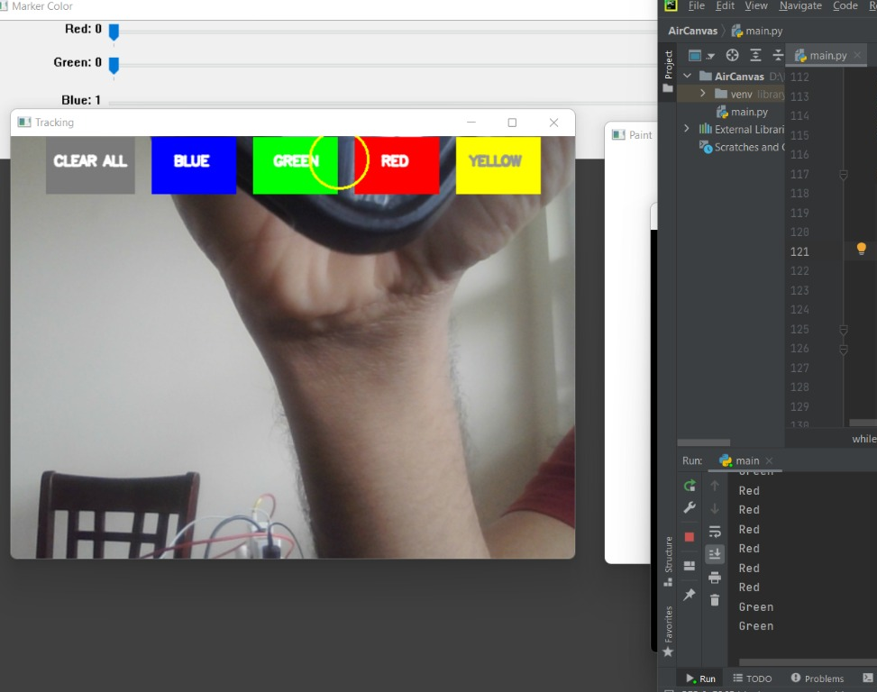
Color buttons
Mainly 5 buttons: clear all, blue, green, red, yellow.
Clear all button to erase all the drawings of the canvas.
Center of the contour falls on the pixel range of any color buttons, the color of the drawings on the canvas change at that moment in real time.

Slide 7
Challenges/Learnings this week
Learning about drawing functions of OpenCV
Feature Calculation function Moments in OpenCv

Slide 8
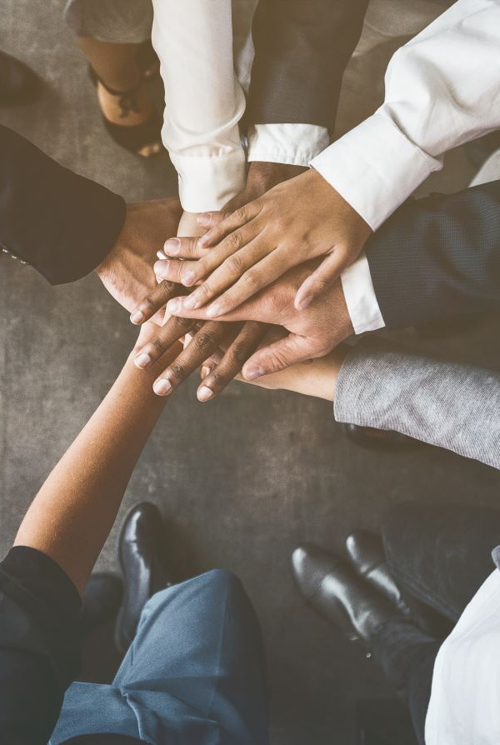
Team collaboration
Connected in Slack for team communication and merged each member’s code using tortoise git
Code reviews were done

Slide 9
Task outline for next week
Draw on the canvas using the hand gestures.
Implement feedbacks received on last presentation in the project after determining whether it is feasible or not.
Start on the final report.

Slide 10

Thank you

